Slide 1
Lecture 3: Kalman filter
April 5, 2016
Notes:
Robbie's conditional and marginal probs?
latent variables, epsilon
ugh I totally forgot about the readings--cressie is particularly good
state space models--process error + measurement error
where latent process has Markovian dependence (e.g., time series)
separability -- joint neg log likes are conditionally independent
correlation vs partial correlation
covariance matrix between a set of variables--two are independent if they have no covariance
partial covariance is inverse of the correlation matrix (??) which is the HEssian
so look at hessian, and if the matrix of second derivatives is zero anywhere, then the two random effects are conditionally independent, GIVEN the values of other random effects
Directed random walk is first order--because it only depends on x_t and x_{t+1}

Slide 2
Likelihood statistics
Problem:
We often can’t write the probability of data given parameters
Examples:
Tag-recapture
What’s the probability of tagging an animal in 2008, seeing it again in 2010 and 2011, and then never seeing it again?
Time-series
What’s the probability distribution for escapement of chinook salmon in the snake river in 2011, given that you’ve sampled escapement from 1980-2010?
Occupancy
Three volunteers look for an endangered butterfly at a site, and only two find it. These volunteers sample at a new site, and none see the butterfly. What is the probability that is present but wasn’t detected?

Slide 3
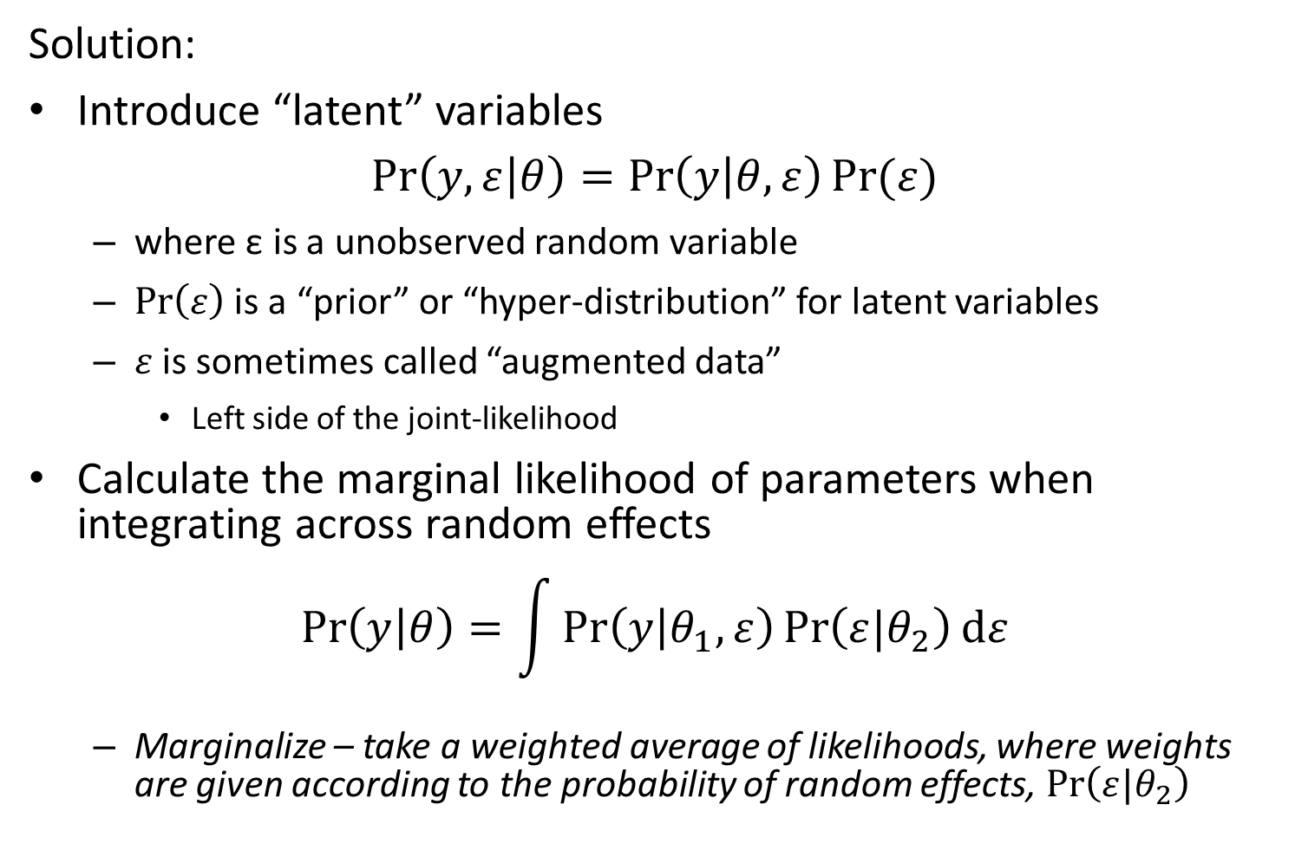
Likelihood statistics
Solution:
Introduce “latent” variables
$$\operatorname{Pr}\left(y,ε | θ\right)=\operatorname{Pr}\left(y | θ,ε\right)Pr⁡(ε)$$
where ε is a unobserved random variable
$\operatorname{Pr}\left(ε\right)$ is a “prior” or “hyper-distribution” for latent variables
$ε$ is sometimes called “augmented data”
Left side of the joint-likelihood
Calculate the marginal likelihood of parameters when integrating across random effects
$$\operatorname{Pr}\left(y | θ\right)=\int{\operatorname{Pr}\left(y | θ_{1},ε\right)\operatorname{Pr}\left(ε|θ_{2}\right)dε}$$
Marginalize – take a weighted average of likelihoods, where weights are given according to the probability of random effects, $\operatorname{Pr}\left(ε|θ_{2}\right)$

Slide 4
Definitions
Term | Definition
Random effect | Coefficient that is “exchangeable” with one or more other coefficients
Hyperdistribution | Distribution for “exchangeable” random effects
Exchangeable | No information is available to distinguish between residual variability in random effects
Fixed effect | Coefficient that is not exchangeable with others, and which hence is estimated without a hyperdistribution
Mixed-effect model | Model with both fixed and random effects

Slide 5
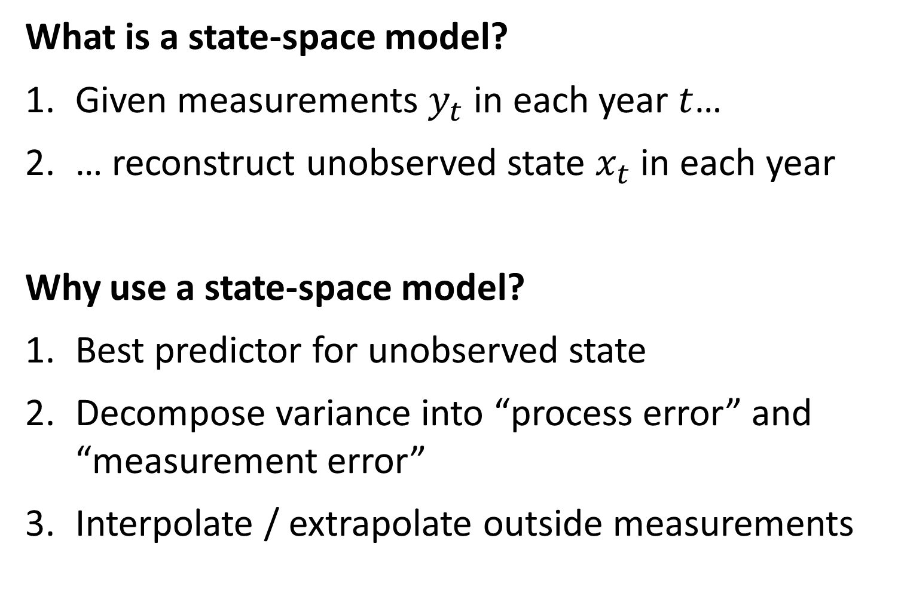
What is a state-space model?
Given measurements $y_{t}$ in each year $t$…
… reconstruct unobserved state $x_{t}$ in each year
Why use a state-space model?
Best predictor for unobserved state
Decompose variance into “process error” and “measurement error”
Interpolate / extrapolate outside measurements

Slide 6

Directed random walk
$$x_{t+1}=x_{t}+ε_{t}$$
$$ε_{t}\sim Normal(α,σ_{x}^{2})$$
$$log⁡(y_{t})\sim Normal(x_{t},σ_{y}^{2})$$
Time-series follows a random-walk with a trend $α$
Notes:
3 variance parameters and
Either vector of random effects x_t
Or coefficients in the number of years

Slide 7
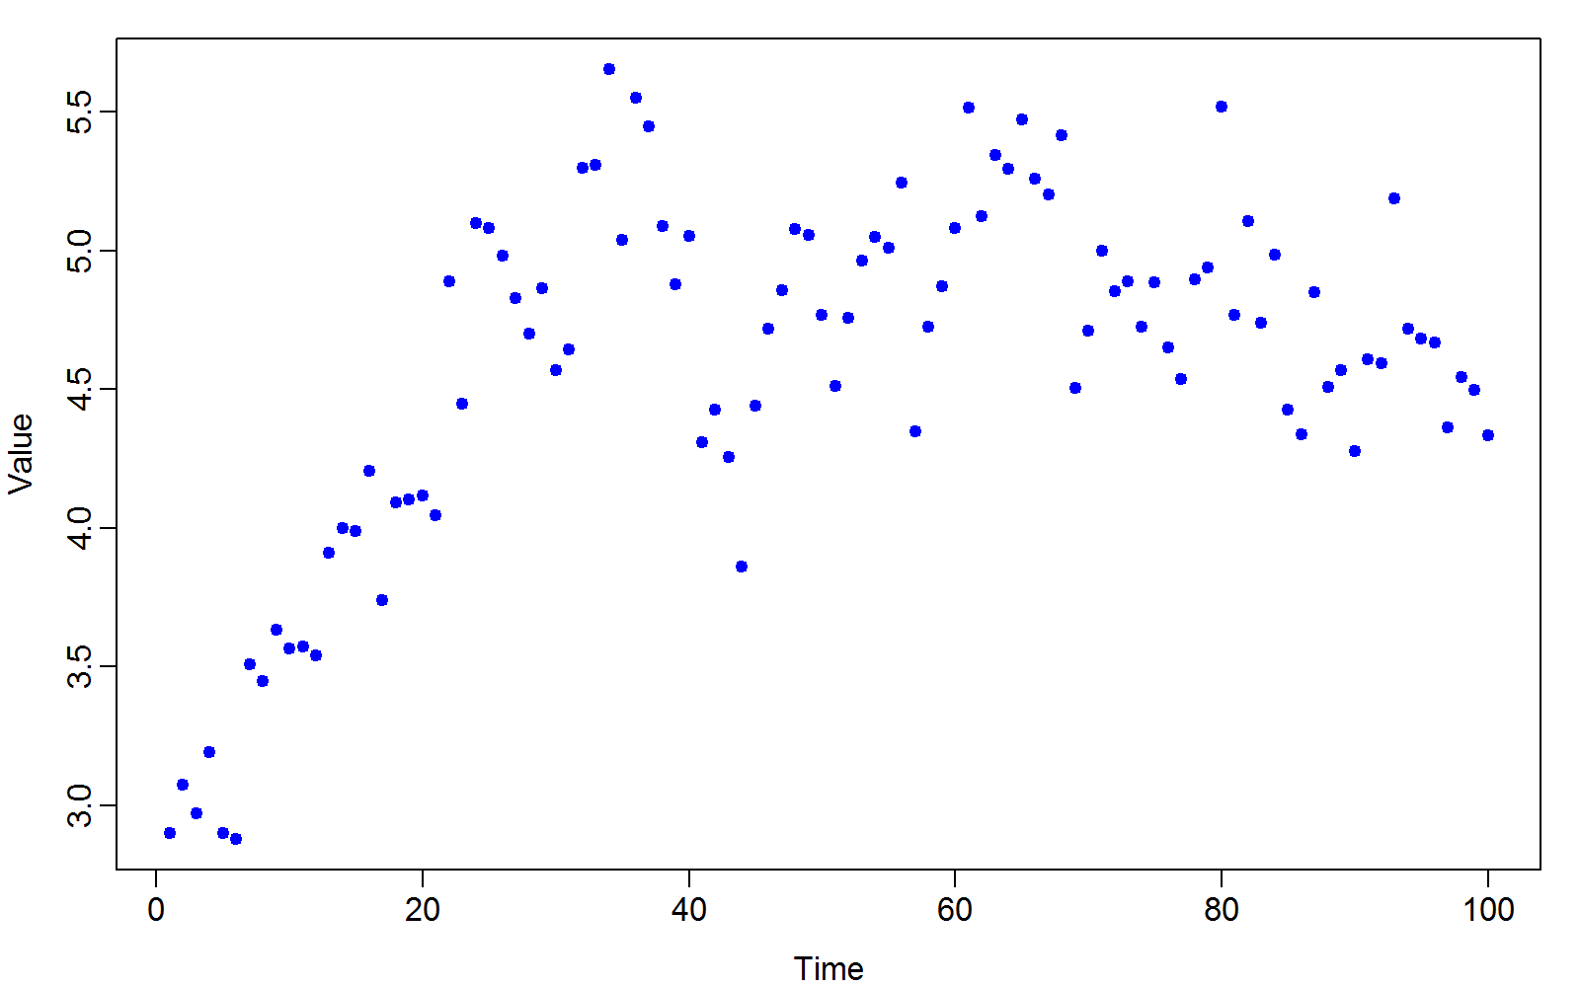
Data set
Notes:
What’s happening past the last observation?

Slide 8
Approaches
Linear model
Loess smoother
Generalized additive model
Kalman filter
Notes:
How does a Kalman filter differ from a state-space model? Specific one that assumes linear evolutions and gaussian errors (normal normal stuff, so there’s an analytical solution)

Slide 9
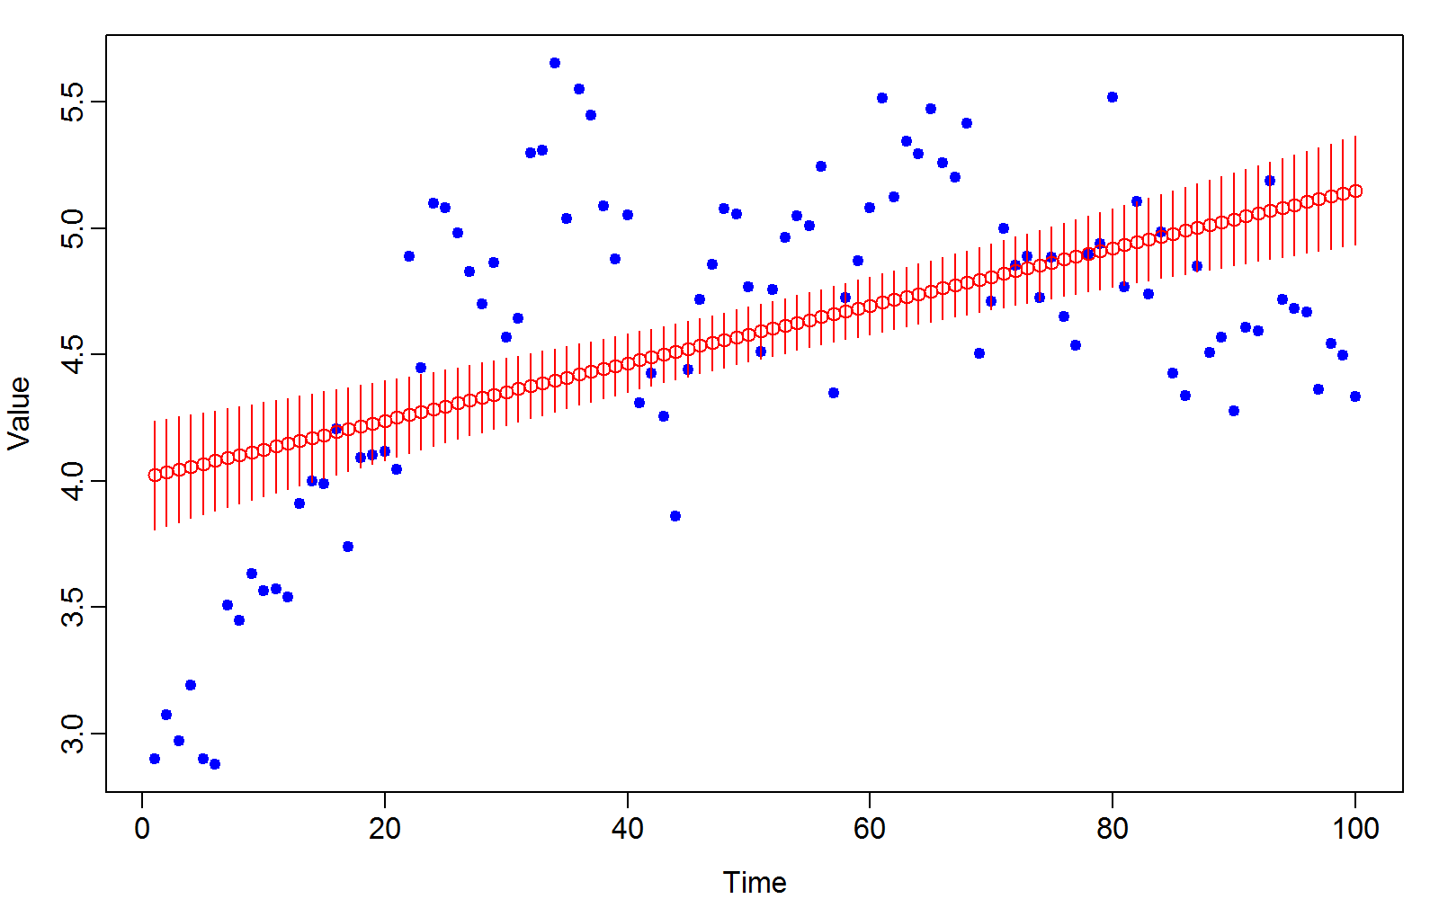
Linear model

Slide 10
Linear model
Problems
Huge residuals at beginning and ending
Predictive variance is larger at beginning and end of series
Doesn’t contain the true value very often
Not sufficiently flexible

Slide 11
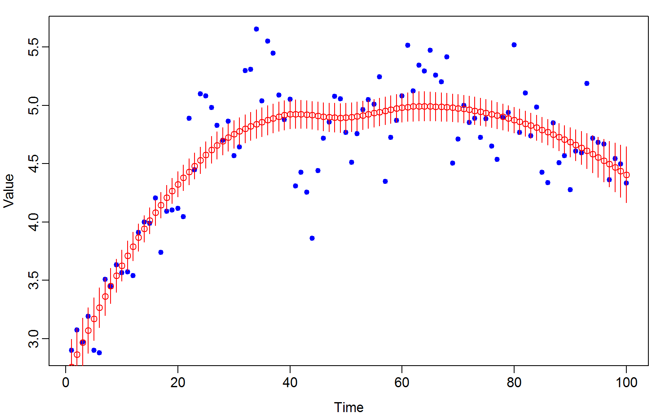
Loess smoother
Notes:
Loess—captures some variability
Why not satisfactory? Tuning parameters are arbitrary—what’s overfit or not? Can’t extrapolate. Doesn’t capture strings of positive and negative residuals, doesn’t look like it’s getting all the time series correlation

Slide 12
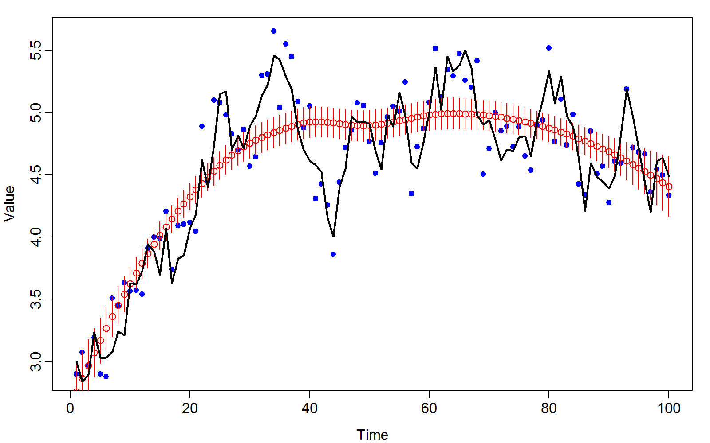
Loess smoother
Notes:
True is the black line
Red is wildly over-smoothing

Slide 13
Loess smoother
Problems
No model to specify
No interpretation of parameters as data-generating process
Confidence intervals don’t include the true values
Seems to “oversmooth”
i.e., strings of years are over/under-estimated
Notes:
No model—no inference besides plot.

Slide 14
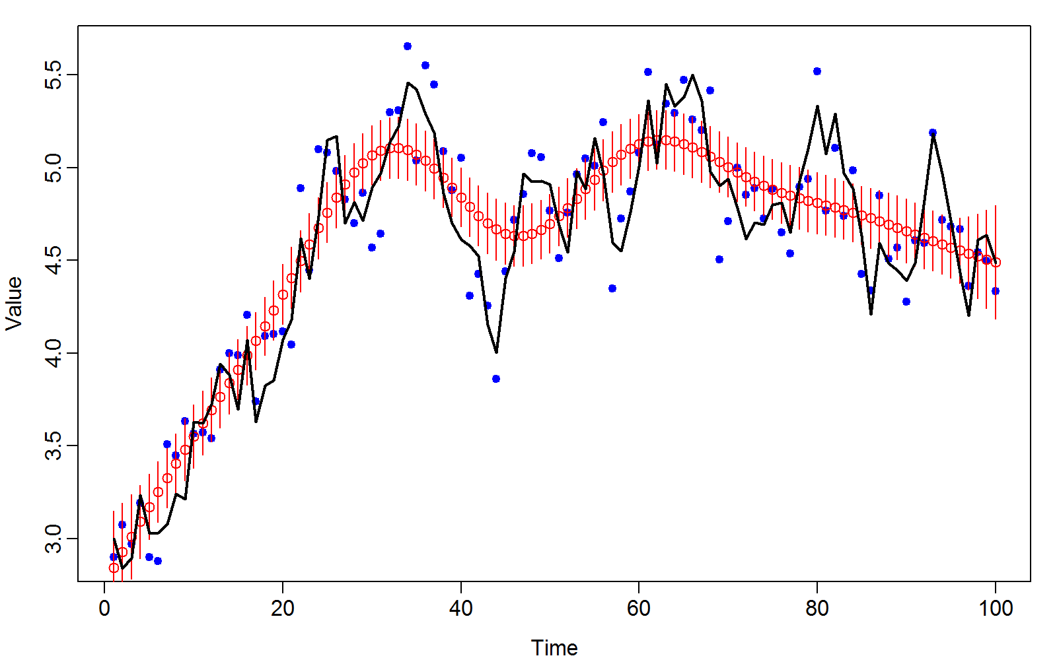
Generalized additive model
Notes:
Better than Loess, picking up some decrease and increase

Slide 15
Generalized additive model
Problems
Confidence intervals don’t include the true values
Misses some fine-scale variation
Notes:
Same problems as Loess—tuning parameters that aren’t interpretable

Slide 16
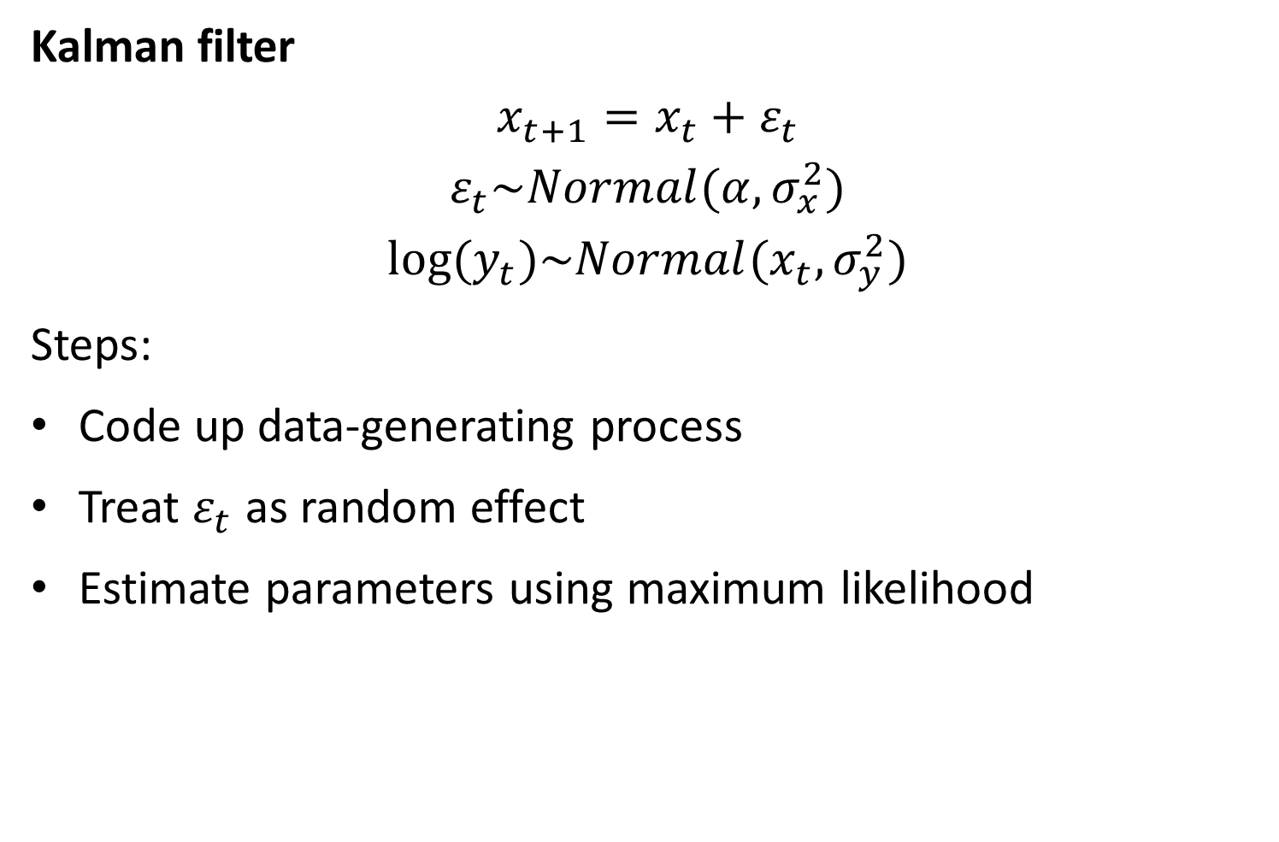
Kalman filter
$$x_{t+1}=x_{t}+ε_{t}$$
$$ε_{t}\sim Normal(α,σ_{x}^{2})$$
$$log⁡(y_{t})\sim Normal(x_{t},σ_{y}^{2})$$
Steps:
Code up data-generating process
Treat $ε_{t}$ as random effect
Estimate parameters using maximum likelihood
Notes:
Fitting the generative model, so it should look good!
Wrinkle in our definition of time series and spatial models.
Different forms of consistency for time series models.
How do you accumulate data in time series?
Lengthen the TS (Andrew Gellman→ infill asymptotics) OR collect more obs at each time (AG → sprawl asymptotics)
And each type of asyptomitcs has it’s own benefits.

Slide 17
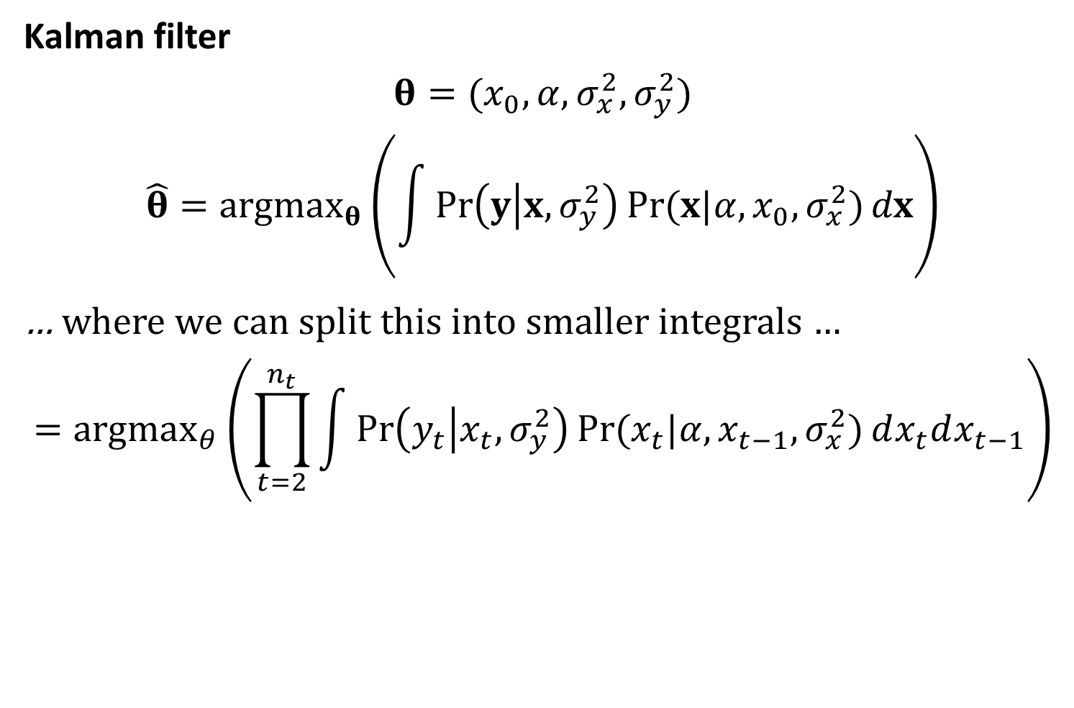
Kalman filter
$$θ=(x_{0},α,σ_{x}^{2},σ_{y}^{2})$$
$$\hat{θ}={argmax}_{θ}\left(\int{\operatorname{Pr}\left(y | x,σ_{y}^{2}\right)Pr⁡(x|α,x_{0},σ_{x}^{2})}dx\right)$$
… where we can split this into smaller integrals …
$$={argmax}_{θ}\left(\prod_{t=2}^{n_{t}}{\int{\operatorname{Pr}\left(y_{t} | x_{t},σ_{y}^{2}\right)Pr⁡(x_{t}|α,x_{t−1},σ_{x}^{2})}}dx_{t}dx_{t−1}\right)$$
Notes:
X_0 is initial state…a parameter
Integral of data given random effects
Because this is first order markov, we know we can split this into smaller integrals
Why is it useful to break up the integral?
Top integral is n_t = 100 (say) dimensional integral, whereas bottom one is a series of 2D integrals (99 of them)

Slide 18
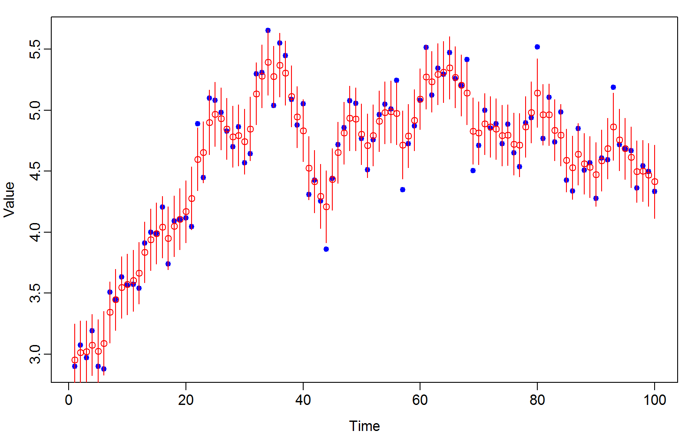
Kalman filter

Slide 19
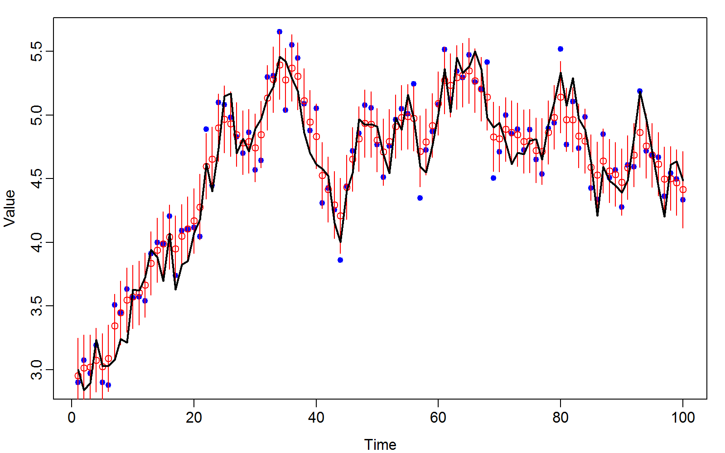
Kalman filter
Notes:
Residuals don’t come in strings, true state is within the interval of the model… nice nice

Slide 20
Kalman filter
Improvements
Specifies an explicit model
Confidence intervals include the true values
Seems to behave intuitively
Predictions are shrunk towards data, and neighboring predictions

Slide 21
3 stages of debugging TMB
1. Crashing R—overrunning a vector
2. compile errors—syntax errors
3. Inner optimizer—not PSD from random effect not affecting the model
How to check which parameter is causing a problem?
Hand code getting the hessian matrix and then do eigen decomp (remind Jim to do this in lab)
4. Simulation testing doesn’t work—detect by simulation

Slide 22
Model in class example runs super fast because it is coded up as separable!
Check this out using INLA
You’ll get the same MLEs either way, but one is much faster. See more in Week 5

